Slide 1

Customer Shopping Behaviour Analysis
Comprehensive insights from 3,900 purchase transactions

Slide 2

Dataset Overview
3,900
18
50
Total Records
Variables
Locations
Purchase transactions analyzed
Data attributes tracked
Geographic coverage
25
Products
Unique items purchased

Slide 3
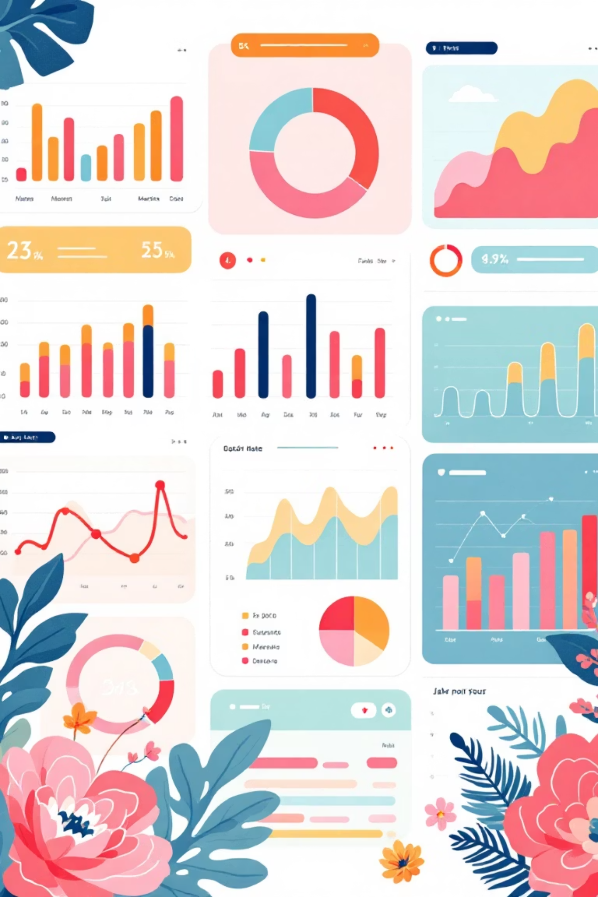
Data Attributes
Demographics
Shopping Behaviour
Age, Gender, Location
Discount Applied
Subscription Status
Previous Purchases
Transaction Details
Review Rating
Shipping Type
Item, Category, Amount
Season, Size, Color

Slide 4





Data Processing Pipeline
Import & Assessment
Loaded dataset, evaluated structure and statistics
Data Cleaning
Imputed missing values, standardized naming conventions
Feature Engineering
Created age groups and purchase frequency metrics
Database Integration
Migrated to MySQL for advanced querying

Slide 5


Revenue by Gender
Male Customers
Female Customers
Higher total revenue contribution across all categories
Significant purchasing power, targeted opportunities
Gender-based marketing strategies could optimize revenue streams

Slide 6
Top-Rated Products
Gloves
Sandals
Boots
3.86 rating
3.84 rating
3.82 rating
Hat
Skirt
3.80 rating
3.78 rating

Slide 7
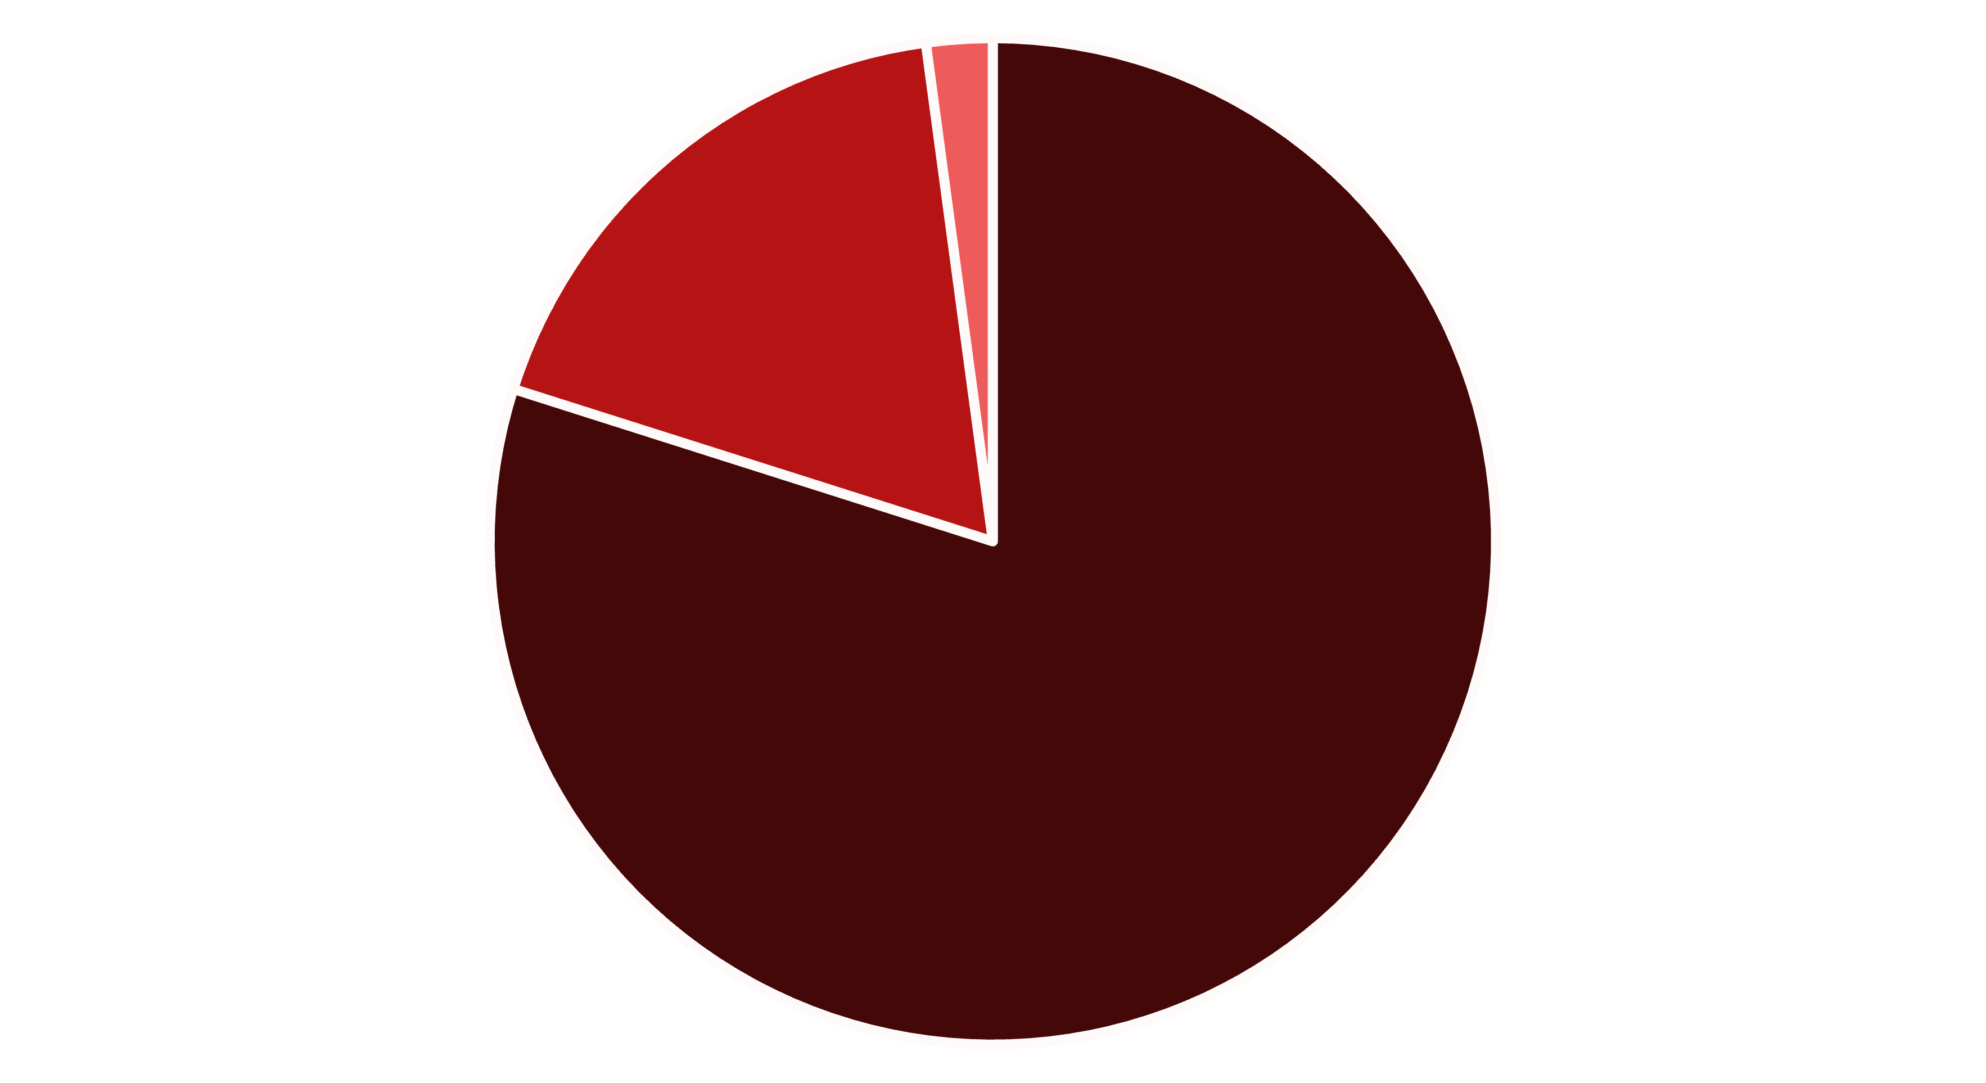
Customer Segmentation
Loyal
Returning
New
Focus on converting New to Returning, Returning to Loyal
Loyal customers dominate with 80% of total base, indicating strong retention

Slide 8
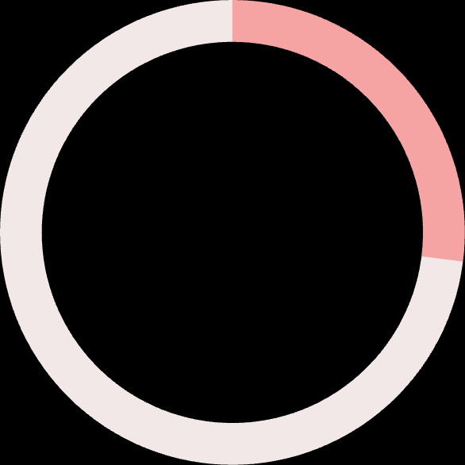
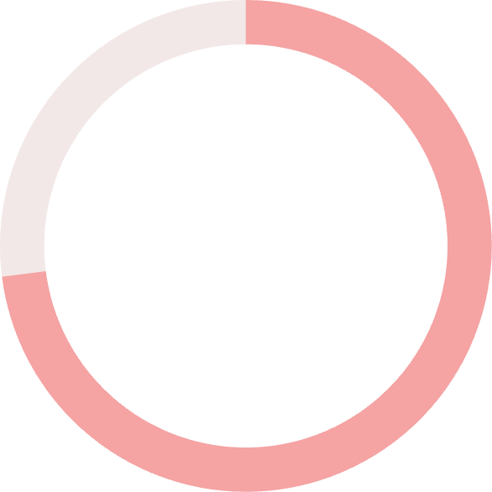
Subscription Impact
Key Insight
Similar average spend ($59.49 vs $59.87), but massive untapped subscription potential
Opportunity: Convert non-subscribers to boost recurring revenue
27%
Subscribed
1,053 customers
73%
Non-Subscribed
2,847 customers

Slide 9

Shipping Preferences Impact
Express Shipping
Standard Shipping
$60
$58
Average purchase amount
Average purchase amount
Express shipping customers spend 3.45% more per transaction

Slide 10
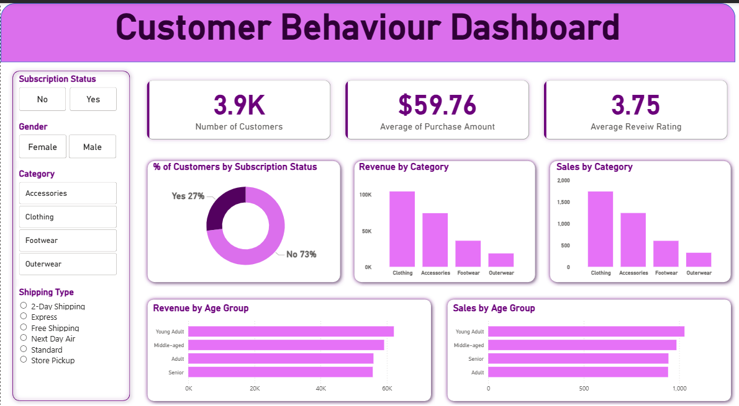
Power BI Dashboard
Interactive visualization platform enabling real-time exploration of customer insights

Slide 11
Strategic Recommendations
1
2
3
Subscription Growth
Loyalty Enhancement
Pricing Optimization
Launch targeted campaigns emphasizing exclusive member benefits
Design rewards to move returning buyers into loyal segment
Balance discount strategy between volume and margin
4
5
Product Promotion
Precision Marketing
Focus marketing on top-rated and bestselling items
Target high-revenue age groups and express shipping users

